Slide 1

Project 4
Team 8 : Frida Delgado // Juan Carlos cano // Alejandro Donjuán

Slide 2

structure
SQL
Python/
Pandas/
Sktlearn
JS
CSS
HTML
Tableau

Slide 3
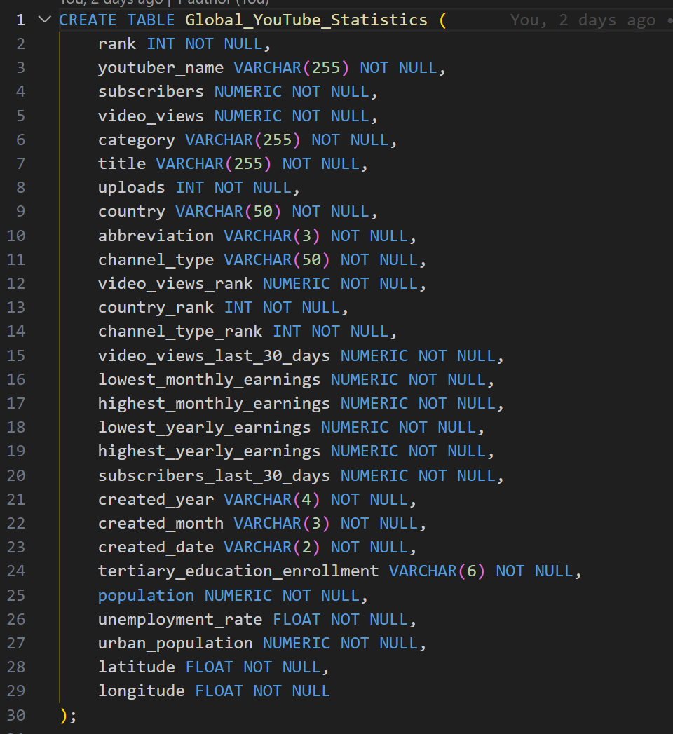
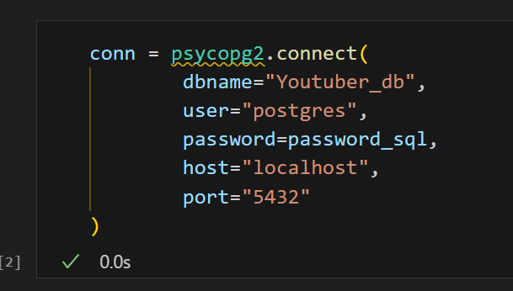
SQL
"We use the psycopg2 library to access the database we created because it has a very simple syntax."

Slide 4
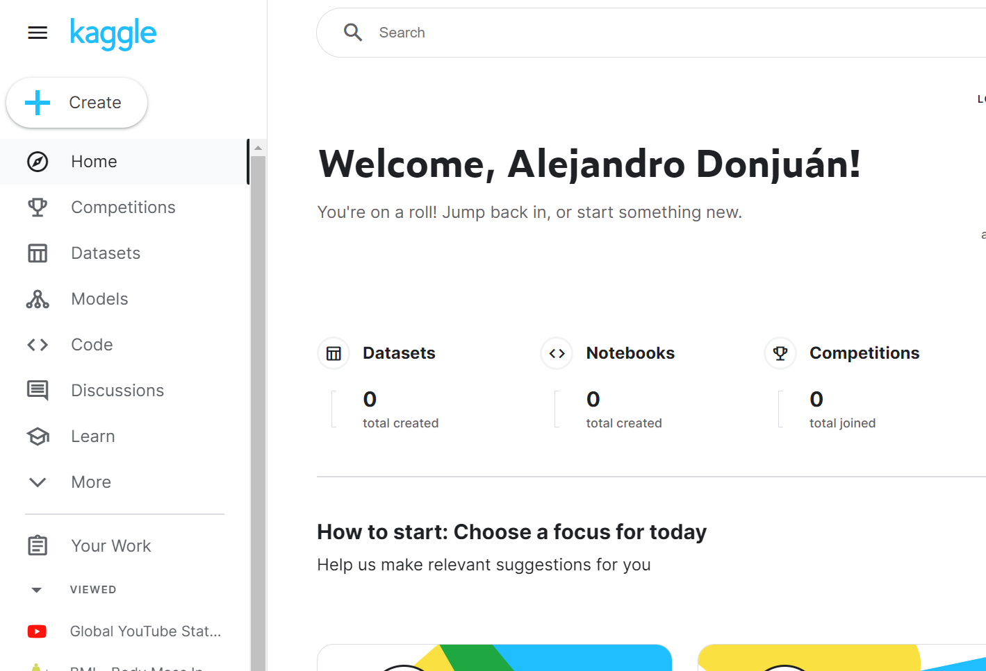
Data
Global Youtube statistics,
1,000 records
update

Slide 5
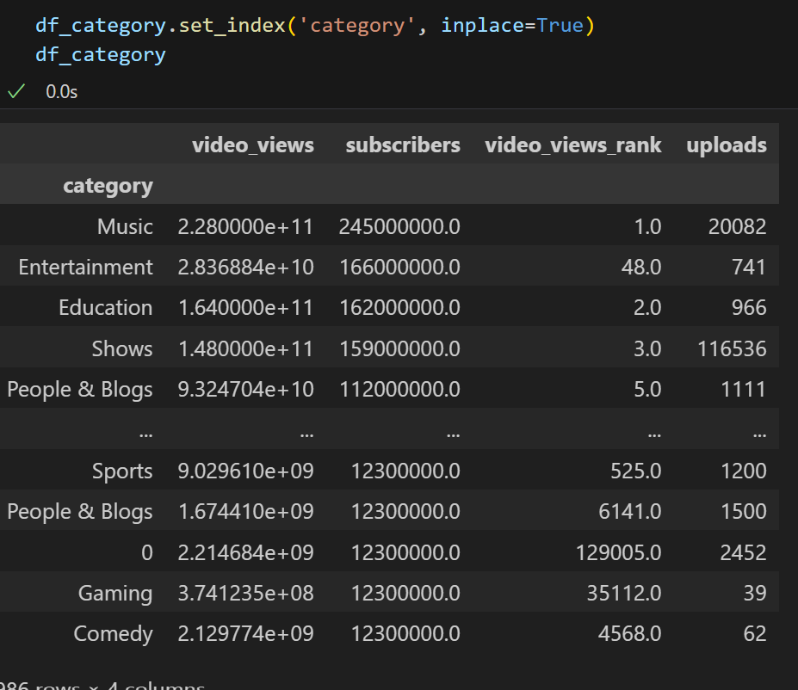
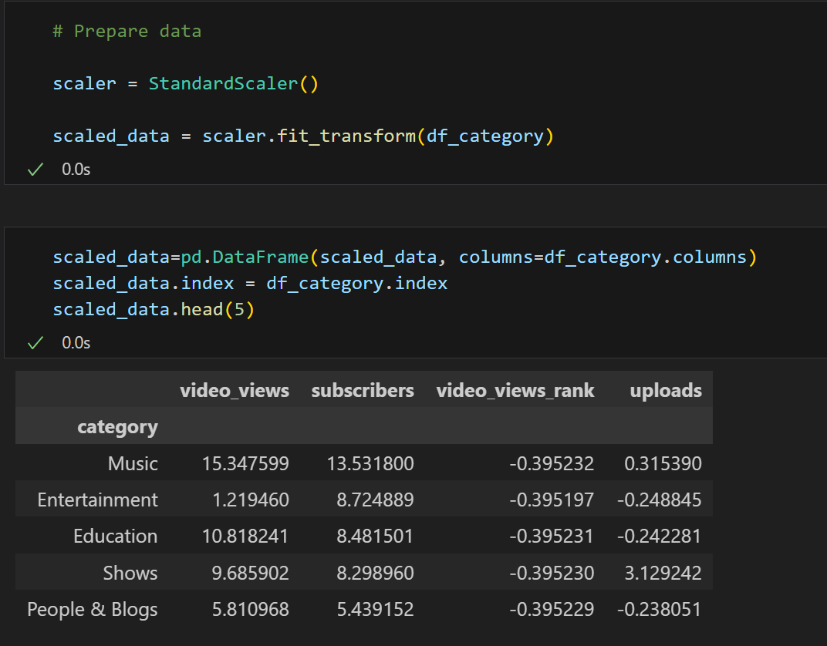
Python // Pandas // sklearn
Create a DF for the model
Scale the data

Slide 6
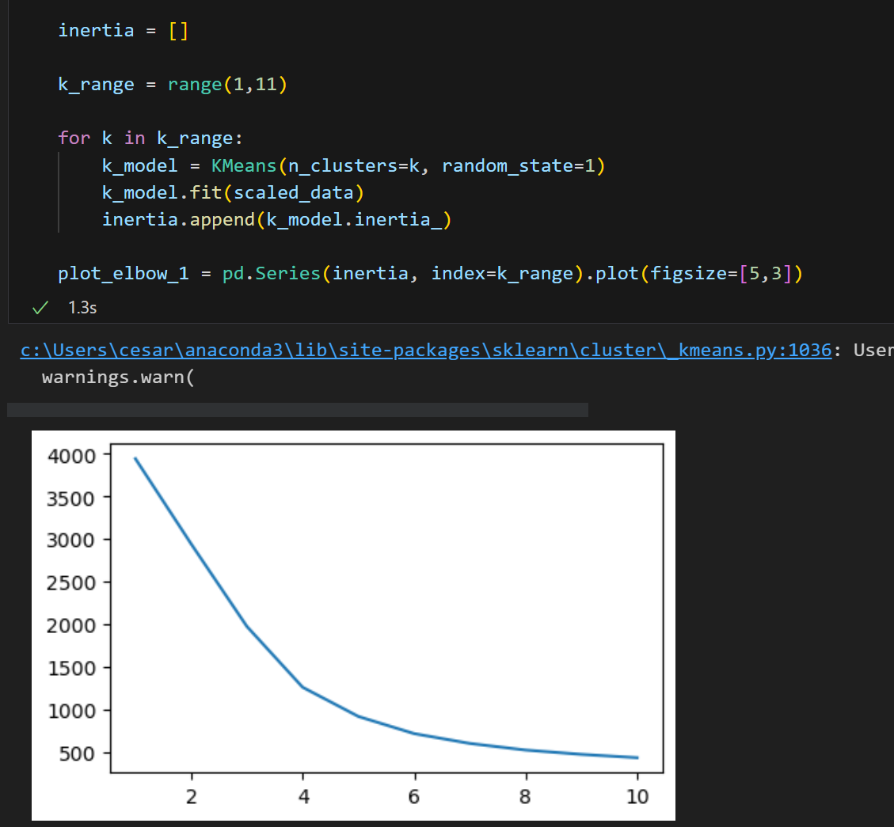
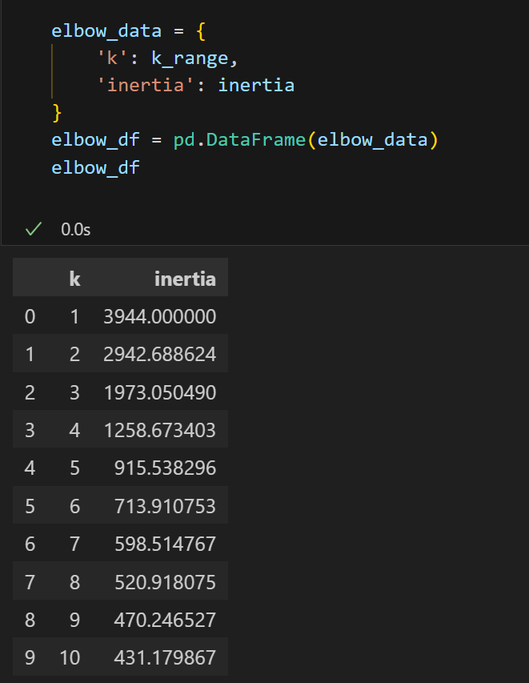
Python // Pandas // sklearn
Elbow plot
Inertia values

Slide 7
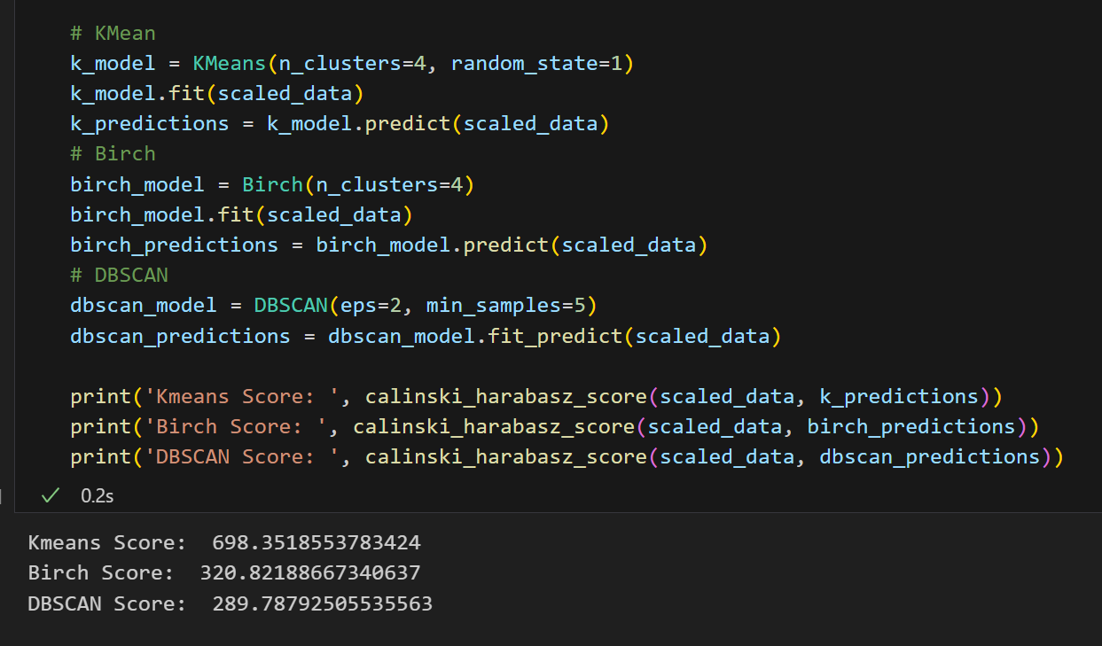
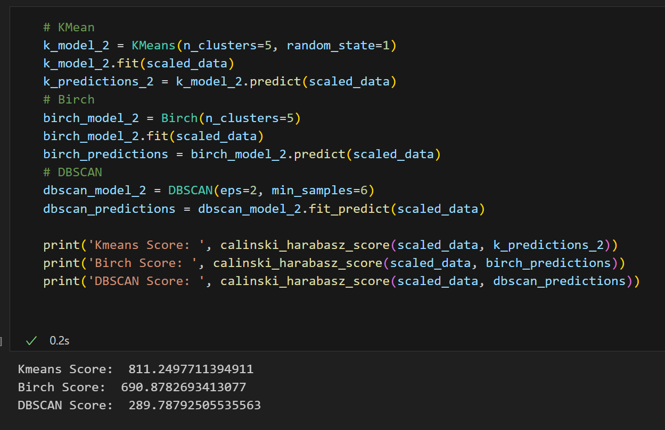
Python // Pandas // sklearn
Model creation // train // evaluation
Model creation // train // Evaluation

Slide 8
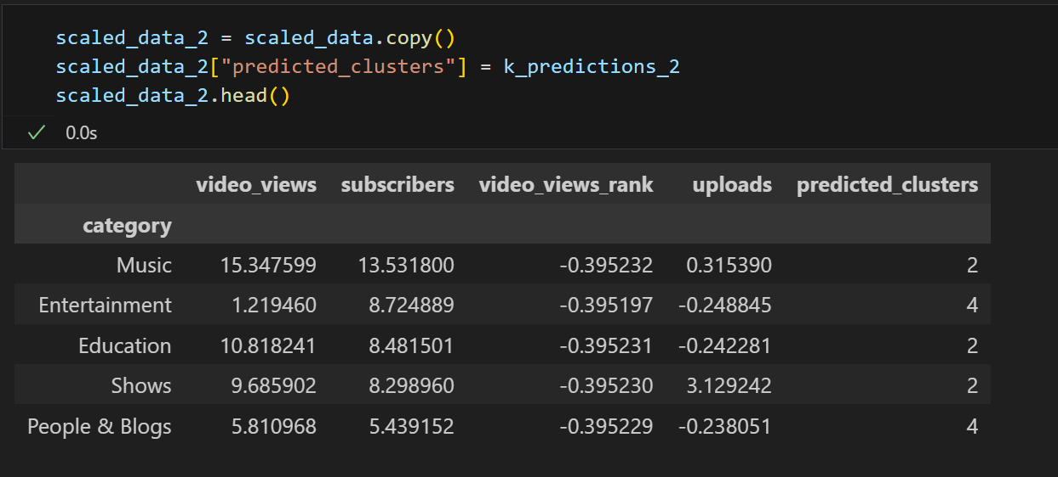
Python // Pandas // sklearn
New DF with predicctions
Scale the data

Slide 9
Python // Pandas // sklearn
Create a DF for the model
Scale the data

Slide 10
Python // Pandas // sklearn
Create a DF for the model
Scale the data

Slide 11
Pandas //Storytelling

Slide 12

Comunicaciones digitales
Nube
Local
Híbrido

Slide 13

Gracias
alguien@ejemplo.com

